Slide 1
2022 Final Budget & Levy Adoption
December 7th 2021

Slide 2
Public Input / Discussion
The Minnesota Department of Revenue provides the following guidance regarding tonight’s meeting:
Final Levy cannot exceed Preliminary Levy
State Statute 275.065 Subd. 6. - Adoption of budget and levy. (a) The property tax levy certified under section 275.07 by a city of any population, county, metropolitan special taxing district, regional library district, or school district must not exceed the proposed levy determined under subdivision 1
Discuss budget and proposed property tax
The proposed property tax levy for the taxes payable year 2022 and the proposed budget for the taxes payable year 2022, must be discussed at the public meeting.
Public comment and questions
The public must be given a reasonable amount of time to comment on the proposed property tax levy and budget and to ask questions. Robert’s Rules of Order may be used to govern the conduct of the meeting.

Slide 3
Fiscal Management
Manage Components of Municipal Budget
Consider Associated Timelines
Small & Steady Increases/Decreases in Levy/Tax Rate Over Time

Slide 4
Property Tax Calculation
Why Tax Rate Is More Important Than Levy Amount
Levy Will Always Go Up Over Time
Tax Rate Provides Better Comparison Between Cities And Years
Tax Rate = Levy / Tax Capacity (Adjusted Market Value)
Property Value X Tax Rate = Property Taxes
Property owners can appeal the assessed value of their property at the annual Local (April) or County (June) Board of Equalization Meeting. Appeals affect the coming tax year, not current tax year.

Slide 5
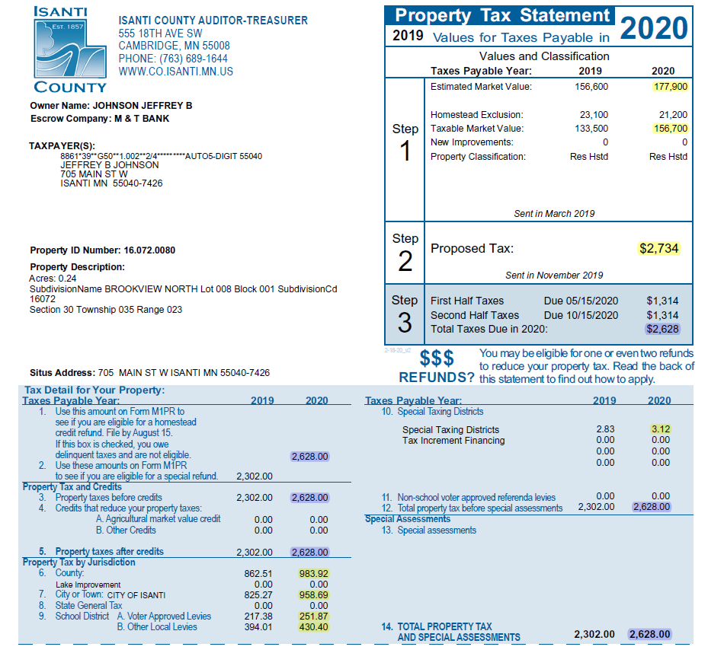
Value Determined by County Assessor, 90-105% of Fair Market Value by Statute
TMV=EMV Less Exclusions
Total Amount Originally Proposed
by Taxing Jurisdictions (September)
Total Amount After Final Adoption
By Taxing Jurisdictions (December)
10. East Central Regional
Development Commission
6. County Tax Amount
7. City Tax Amount
9.A/B. School District Tax Amount

Slide 6
Components of Municipal Budget
Category | Revenue | Expense | Competency
Operating Rev/Exp | GF Levy / Rates | 3-5 yr Avg., 6m Actual | All - Easy But Not Assured
Intergovernmental Rev/Exp | LGA / Grants | Regulations / Legislation | All - Legal Requirement
Capital Projects | Levy / Rates | 10-20 year Horizon | Most - $ to Engineer
Capital Maint./Replacement | Levy / Rates | 20 year Horizon | Few - Difficult **
** Largest Available Marginal Competitive Advantage

Slide 7
Budget Options to Consider
Delaying Street Improvement Projects
  All current projects were originally identified in 2010
Delay / Eliminate Capital Maint/Replacement Items
  All items have been identified as needed
Reduce Operating Expenditures
  Contracts and other legal obligations limit scope of possible cuts

Slide 8
Budget Summary

Slide 9
Budget Summary

Slide 10
Fiscal Management
Small & Steady Increases/Decreases in Levy/Tax Rate Over Time
Manage Components of Municipal Budget
  Operating Rev/Exp
    Staffing, PRC Programming, Road Maint., Snow Removal, Police Presence/Patrols, Fire Protection
    Capital Projects
      Identify and fund on consistent annual basis. Expenditures will vary annually but revenue collection should be consistent and predictable
      2028 is scheduled for 1.37 million in expenses. 2028 levy for street projects expected to be 352k.
      Avoid issuing bonds (debt) whenever possible. Borrowing 1 million costs roughly 250k in interest and issuance costs
      Capital Maintenance/Replacement
        Identify and fund on consistent annual basis. Expenditures will vary annually but revenue collection should be consistent and predictable
        2025 is scheduled for 2.85 million in expenses. 2025 levy for Capital Maint/Replacement is expected to be 494k
        20-year plan should include ALL maintenance and replacement items. From squad cars and plow trucks to tuck pointing brickwork
        Review annually and only replace when needed. If equipment performs beyond expected useful life, move scheduled expense to following year and reevaluate.

Slide 11
Considerations in Setting Levy
Capital Project Funding
  Next 10 years of street projects identified in 2010 to begin in 2012
  Capital Maintenance/Replacement Funding
    20-year cash flow analysis
    Fund Balance – General Fund
      85k annual repayment to Water/Sewer Funds for Hotel Project, 10 years
      26k annual repayment to Liquor Fund for 2018 Improvements, 10 years

Slide 12
Proposed Levy
LEVY | 2022 | 2021
GENERAL FUND LEVY (101) | $ 2,150,000 | $ 1,880,700
CAPITAL MAINT. LEVY (920) | $ 451,900 | $ 438,700
STREET CONST. LEVY (425) | $ 295,000 | $ 286,500
EDA LEVY (108) | $ 98,038 | $ 86,201
ABATEMENT LEVY (101) | $ 13,763 | $ 13,432
DEBT SERVICE LEVY | $ 273,150 | $ 281,630
930 - 2011A GO BOND | $ -0- | $ 9,367
931 - 2014A TAX ABATEMENT | $ 223,821 | $ 222,036
932 - 2014B GO BOND | $ 49,329 | $ 50,227
TOTAL LEVY | $ 3,281,851 | $ 2,987,163

Slide 13
Levy History

Slide 14
Proposed Tax Rate
 | 2022 | 2021 | CHANGE FROM PRIOR
TAX RATE | 58.48% | 60.40% | -3.17%
AVG. TAX RATE - 2007-2020 | 67.08%
% ABOVE (+) / BELOW (-) AVG. | -12.82%

Slide 15
Tax Rate History

Slide 16
Levy / Tax Rate History

Slide 17
Competitive Metric

